Slide 1
Music Recommendation Based on Face Emotion Recognition

Slide 2
Introduction
Facial expressions give an important ideas about emotions. Face emotion is used in areas of security, entertainment. They give a brief idea about person’s mood which can be helpful in many ways.
Music plays a very important part in an individual’s life as it’s the source of entertainment and has a therapeutic approach. Nowadays music players have many new advancements like reverse, quick forward, shuffle, etc. Although these advancements help the users, but they consume a lot of their time as the user has to manually browse through the playlist. So here facial expressions play a vital role as they can detect whether a person is happy, sad or surprised. Here the mood based music player comes into role. It helps in generating a playlist according to the mood detected through various algorithms . This eases the work of the users and can be really helpful.

Slide 3
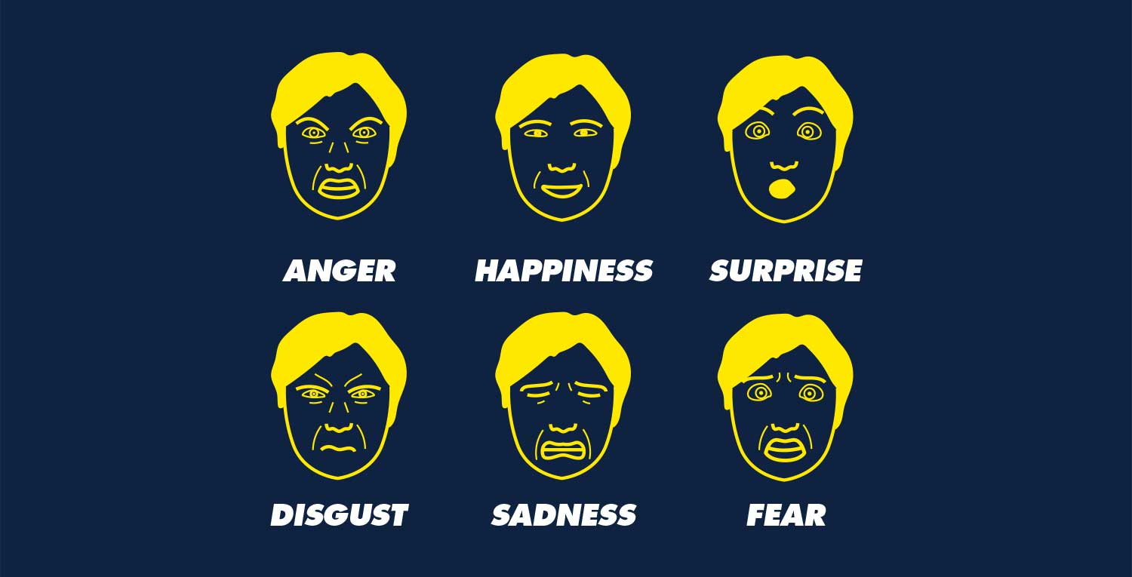
Face Emotion
There are six type of face emotion

Slide 4
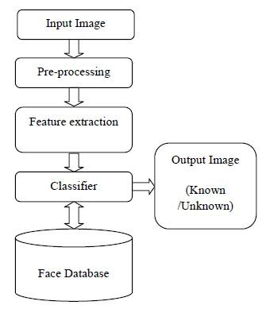
Block diagram

Slide 5
Methodology
The various steps to be implemented are :
Face Detection
Facial Extraction.
Emotion Classification
Interfacing

Slide 6
Face Detection
For detecting the face , there are various different algorithms available.
We are going to work with Viola Jones algorithm.

Slide 7
Viola Jones Algorithm
It is divided into 4 steps:
Haar feature Selection.
Creating Integral Image.
Adaboost training.
Cascading Classifier

Slide 8
HAAR FEATURE SELECTION
Haar features are rectangular features or a sliding window which are selected upon the required features. They are vertical and horizontal pixels.

Slide 9
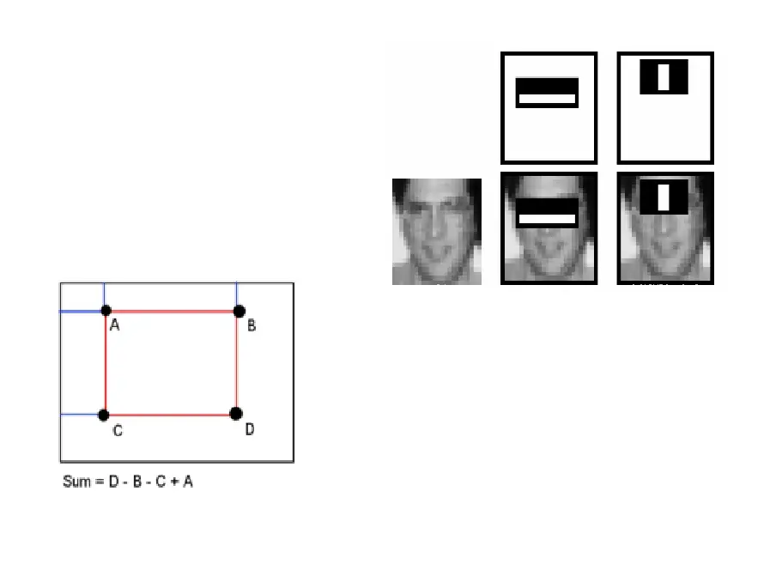
types of features :
Edge features.
Line features.
4 Rectangular features

Slide 10
INTEGRAL IMAGE
An integral image calculates summations over image subregions. Every pixel in an integral image is the summation of the pixels above and to the left of it.
It reduces the calculations for a given pixel to an operation involving just four pixels.

Slide 11
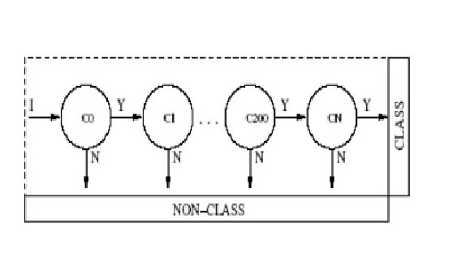
ADABOOST TRAINING AND CASCADING CLASSIFIER
From 16000 features only relevant features are selected and the rest are discarded . For this, we apply each and every feature on all the training images . We select the features with minimum error rate, which means they are the features that most accurately classify the face and non-face.
The final classifier is a weighted sum of these weak classifiers. It is called weak because it alone can't classify the image, but together with others forms a strong classifier . The final setup has around 6000 features.

Slide 12
FACIAL EXTRACTION
It is implemented using.
Extracting facial patches.
Passing in on to Local Binary pattern.
Using Principal Component Analysis.
Classifier.

Slide 13
LBP generates the binary code that describes local texture pattern by normalizing the intensity values in neighbor hood.
The eyes , nose region is extracted from LBP face image and LBP histogram is drawn for each pixels of the image.
LBP recognizes face image with 8 neighborhood of pixels using value of centre pixel as threshold .If the value of the pixel is higher than the central pixel then 1 is set and if not then 0.Then it is read to form the binary number. Finally compute histogram of each cell over frequency of that number .
PCA is applied on the LBP feature vector to reduce the feature vector size . Calculate mean of LBP feature vector. Derivation to make covariance calculation error. Calculate covariance matrix using standard formula . Eigen vectors and value is covariance matrix are taken. Then reduce dimensionality by eliminating the Eigen vectors . The Eigen vector with highest Eigen value is principal component of dataset .
Finally it is passed on to the classifier.

Slide 14
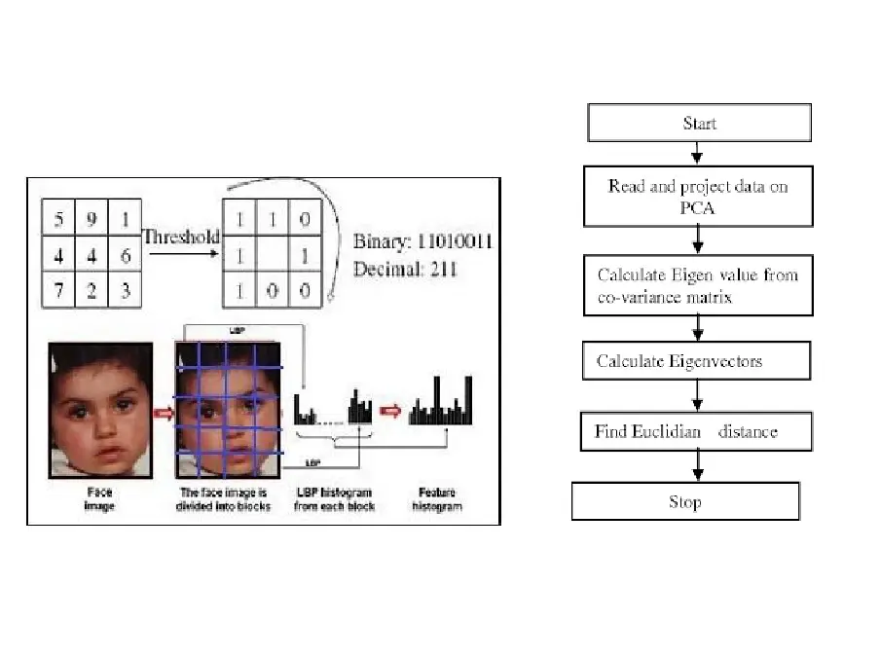

Slide 15
CLASSIFIER
Classification is a general process related to categorization. It is the action or process of clustering something. System is capable to classify images into different emotions . For classification of images, system will use Support Vector Machine (SVM). There are two phases in preparing an efficient classifier :
Training Phase: The training dataset is divided into three classes for three moods i.e. happy, surprised, and sad , for each of these corresponding mood values +1 ,+2, and +3 is assigned in the training file as the correct label for this model to train. Here giving feature point along with its correct label is at most important as the learning of the model is supervised learning. The feature point are the position of the landmark on the face which were calculated in the previous step of feature extraction these feature point are converted in a single dimension from a two dimension X,Y coordinate system.
Testing phase: In testing phase , a similar input is given to the train model as it was in training phase with an exception that correct label is not known by the system for predicting the mood. It is just use to check the accuracy of the predicted result.

Slide 16
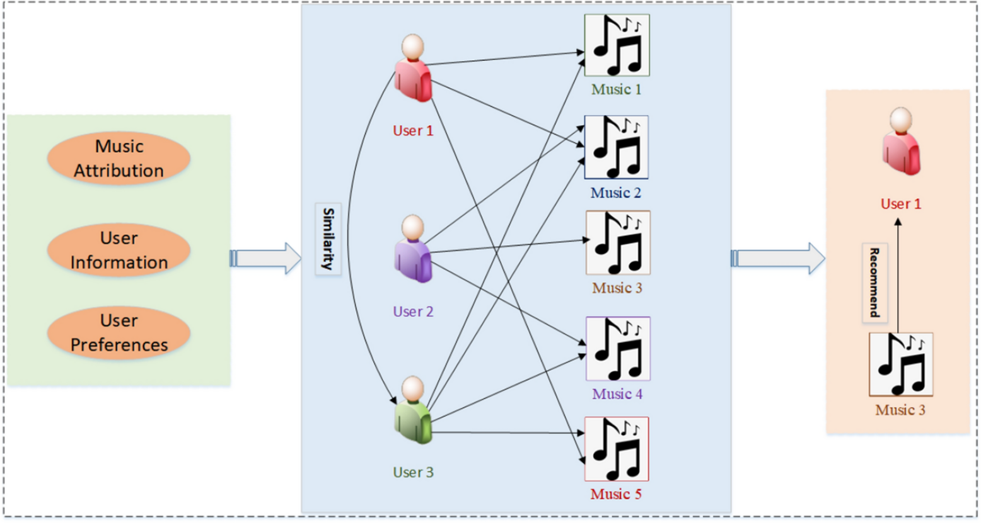
Result

Slide 17
Conclusion
After searching for different methodologies for face detection ,feature extractions, we decided on using Viola Jones for face detection ,Local Binary pattern and Principal Component Analysis for extracting features and Support Vector Machine as Classifier.
Database we are going to use is CK+, which has both male and female faces consisting of 7 moods , of which we are going to take 4 moods viz happy, surprised, sad and angry.

